Slide 1
Smart Home system
Batoul Noureddine
Celine Yussef

Slide 2
Content
Introduction
Description
Components
Full code
Pictures
Video
Conclusion

Slide 3
Introduction
Our Smart Home system enhances convenience and security with automated features, controlled by simple user interactions to create a more interactive and efficient smart home experience.

Slide 4
Description
This Smart Home project integrates various components to create an automated and interactive living space. The user initiates the system by pressing a push button, which triggers a doorbell sound and prompts an LCD display to show "Welcome please enter the pass." The user then enters the passcode using a keypad. If the passcode is incorrect, the LCD displays "Wrong," and a piezo plays an error sound, allowing the user to try again.
Once the correct passcode is entered, the main home door opens, and the outdoor lights turn on, with the LCD displaying "Correct." In the bedroom, an ultrasonic sensor detects motion, causing the door to open automatically, and the LCD to display "Motion detected." The door then closes after a few seconds.
The home also features a water pool with a water level sensor. When the user presses a push button, a 4-digit seven-segment display shows the water level. Lastly, a fan turns on or off with a push button press.

Slide 5
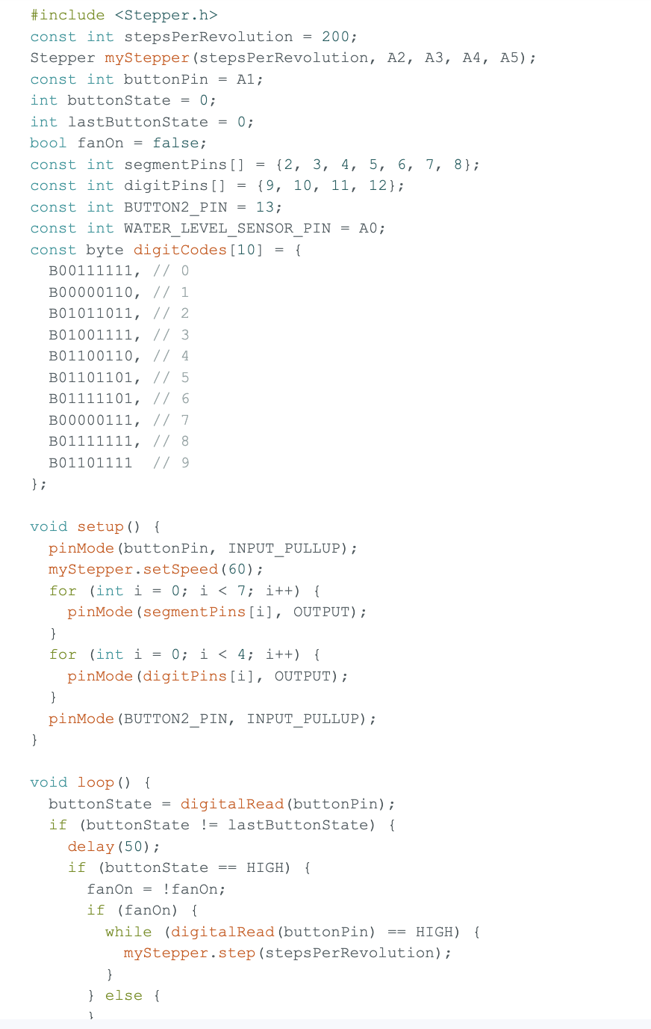
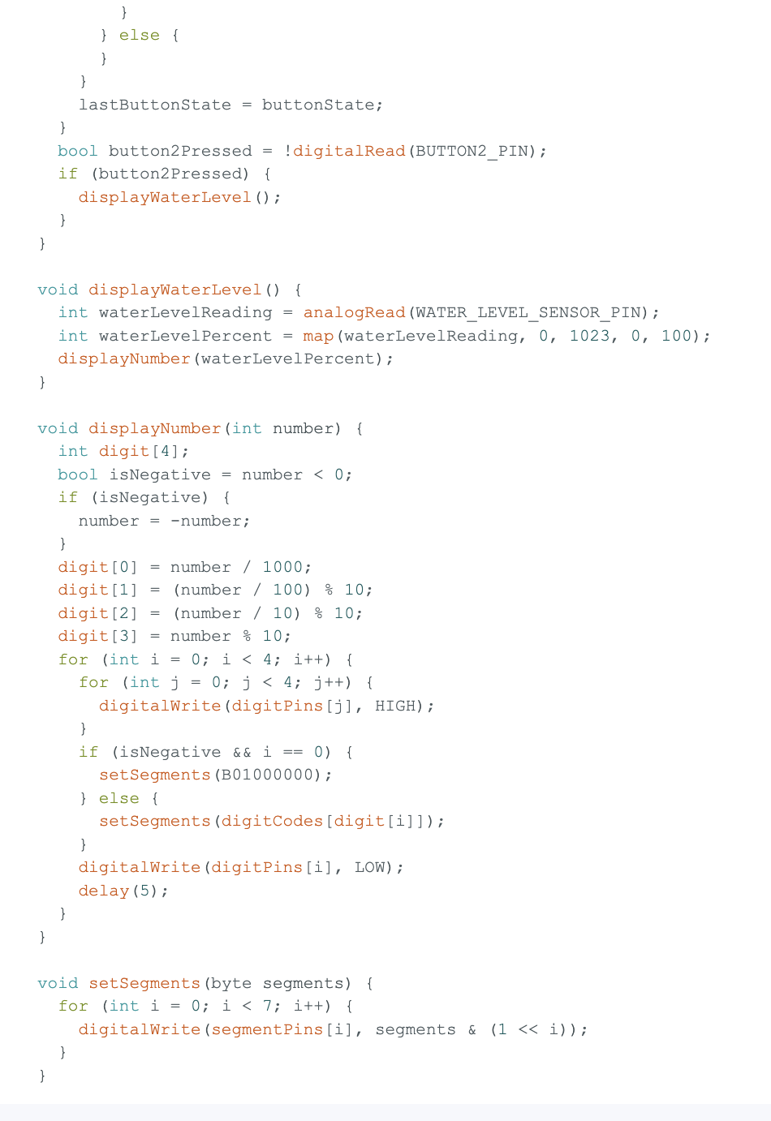
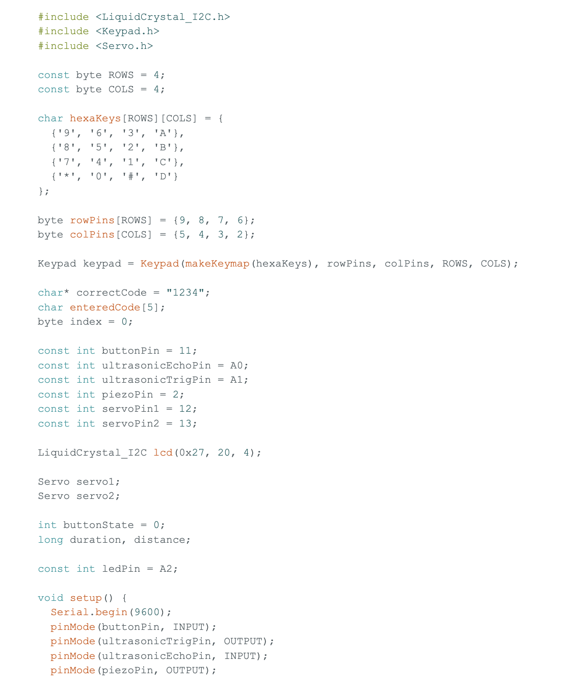

Slide 6
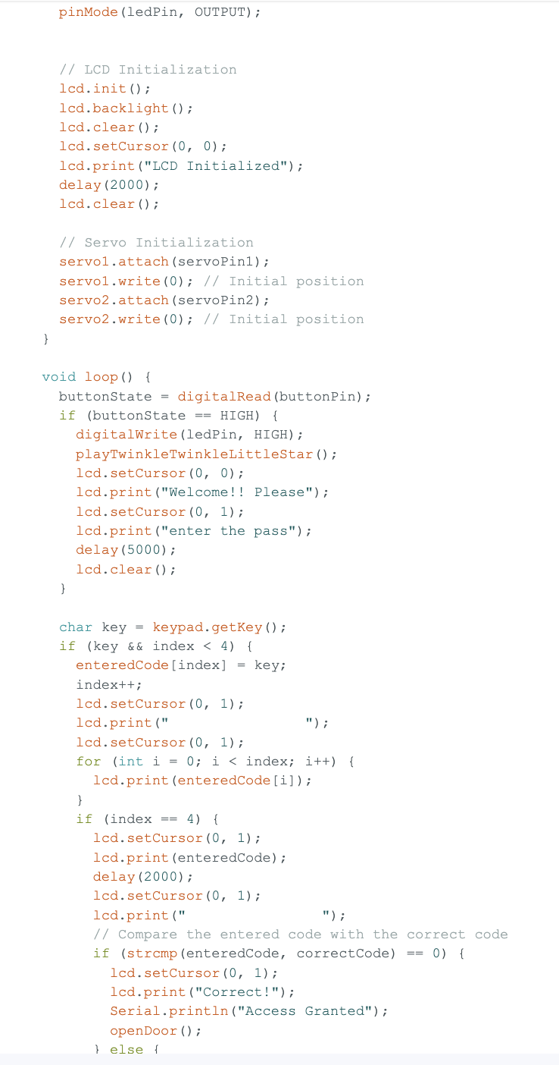

Slide 7
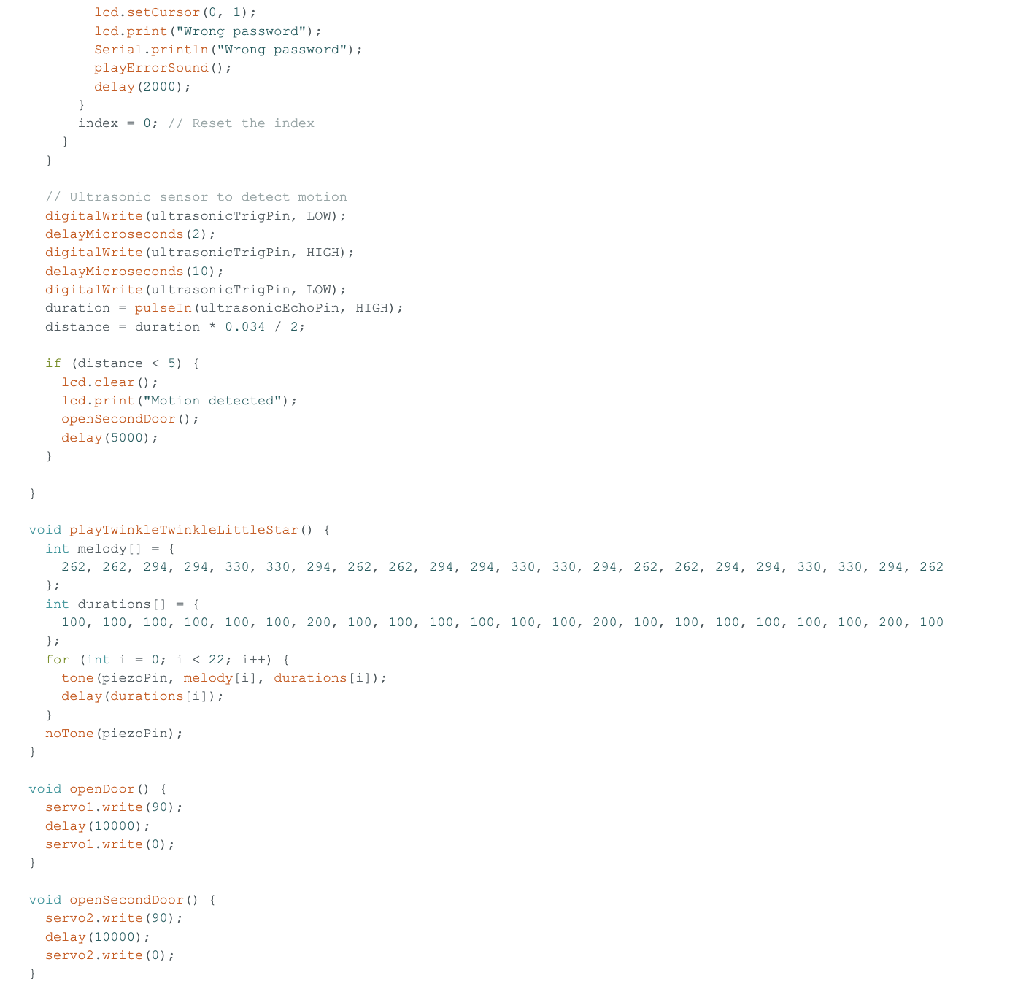
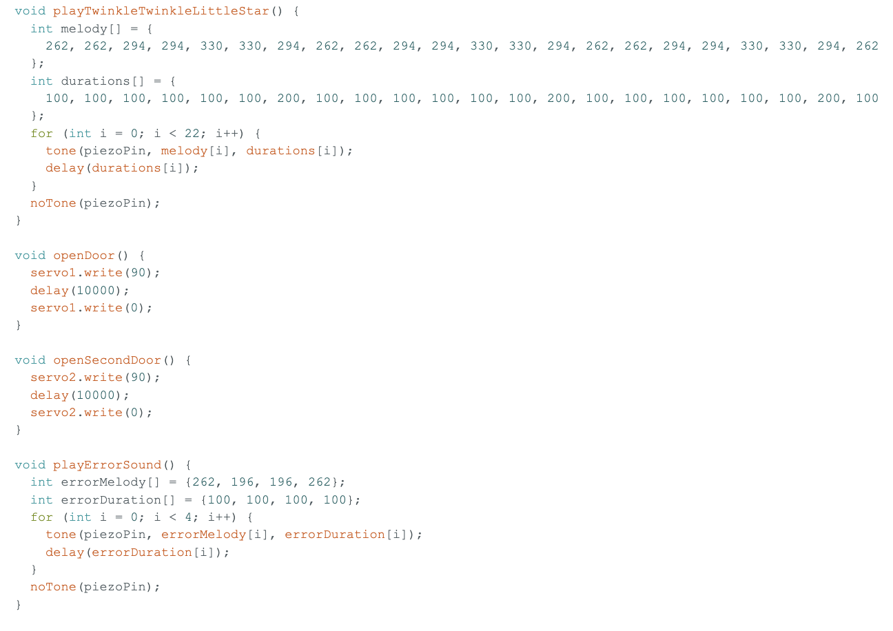

Slide 8
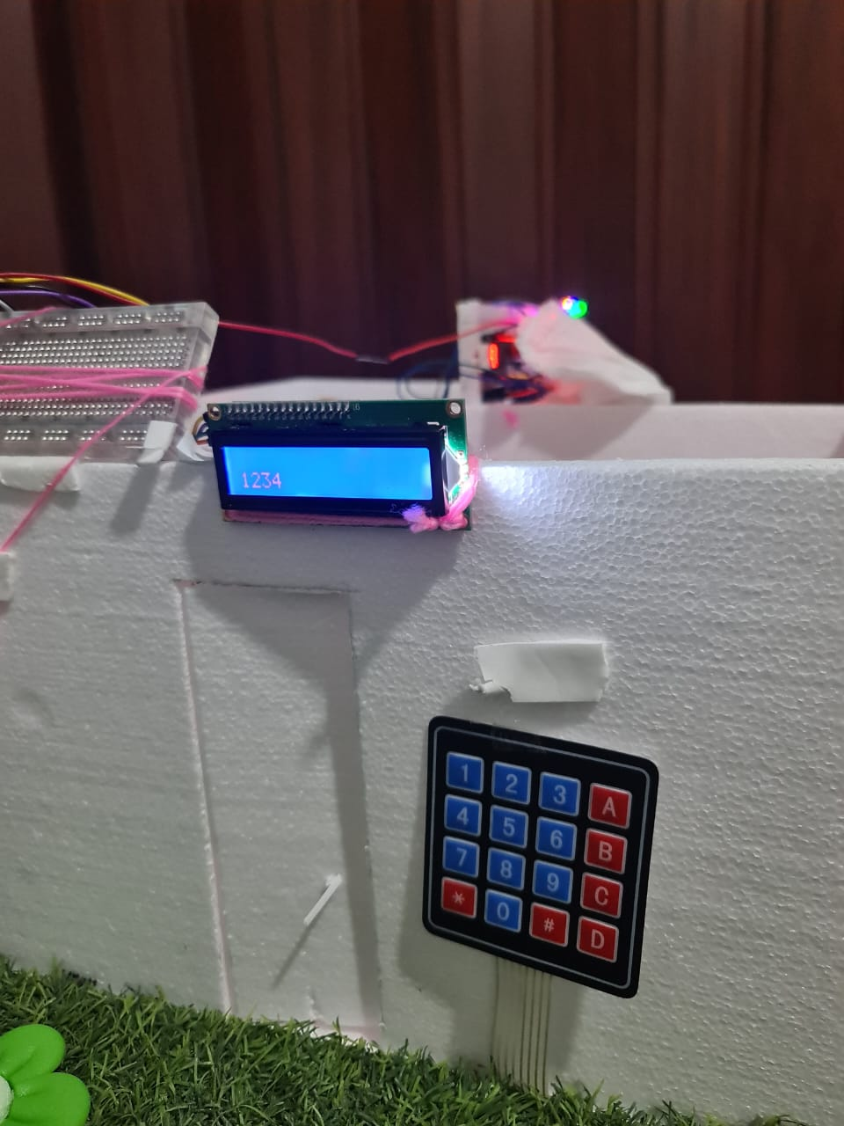
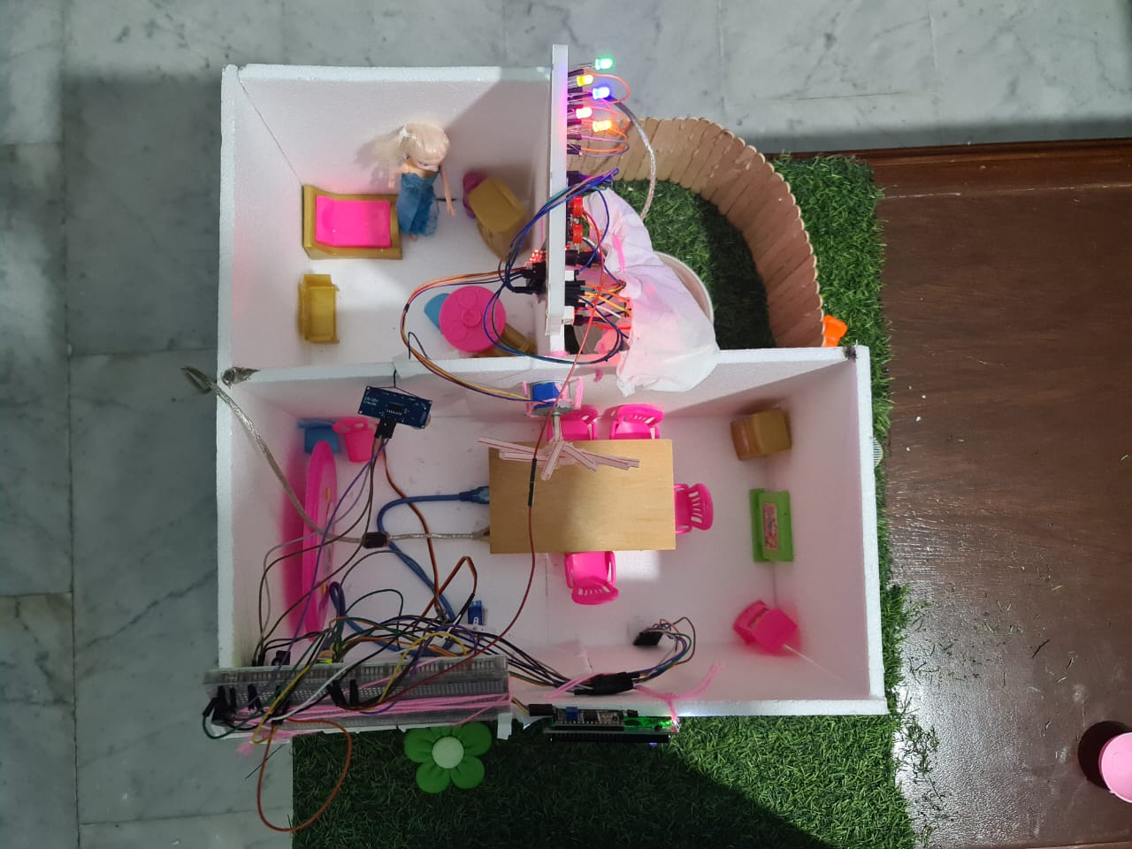
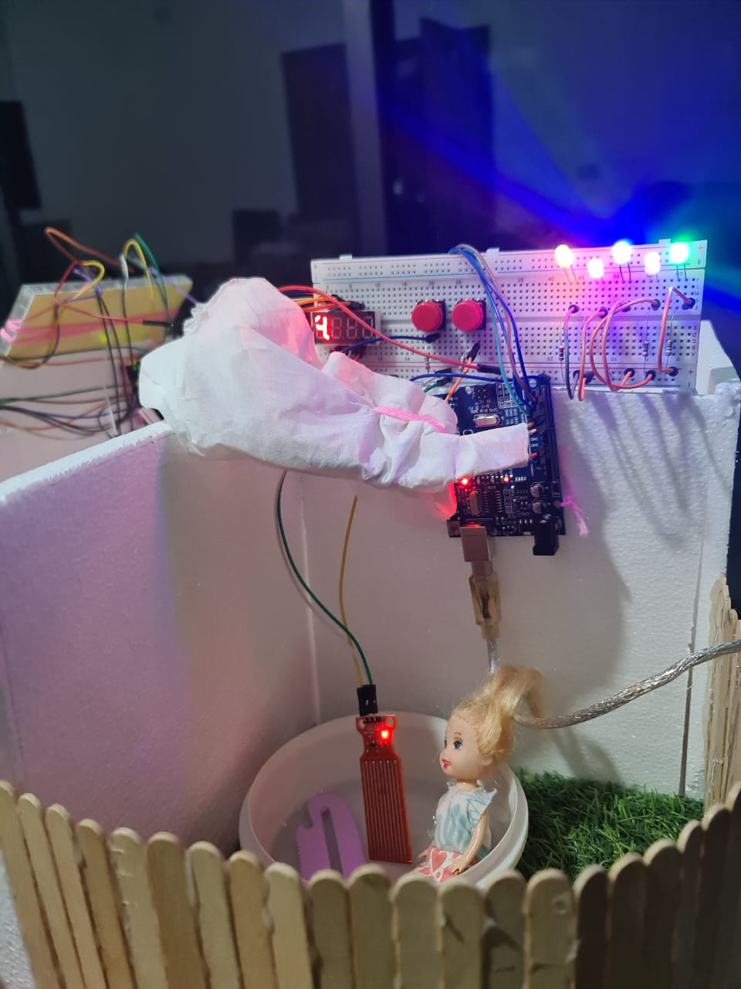
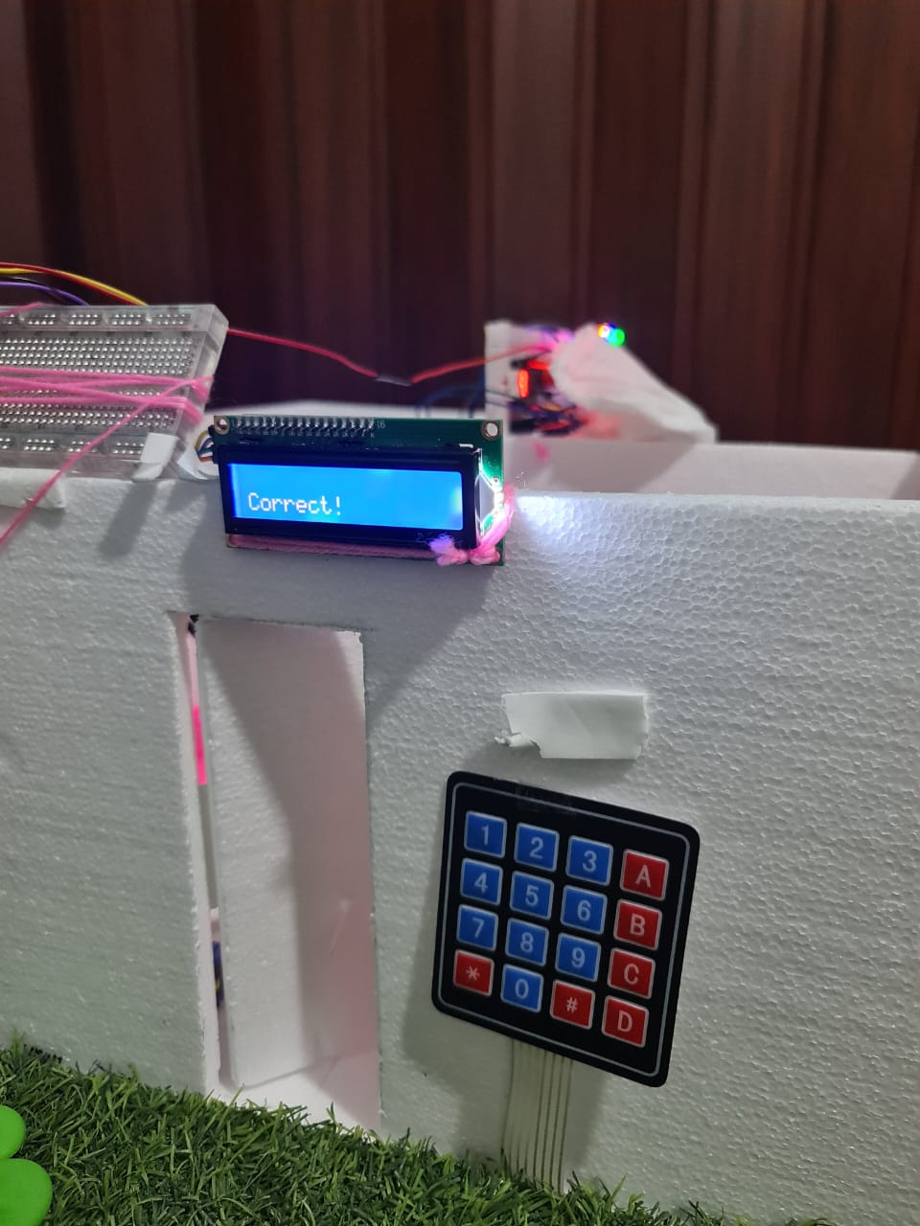
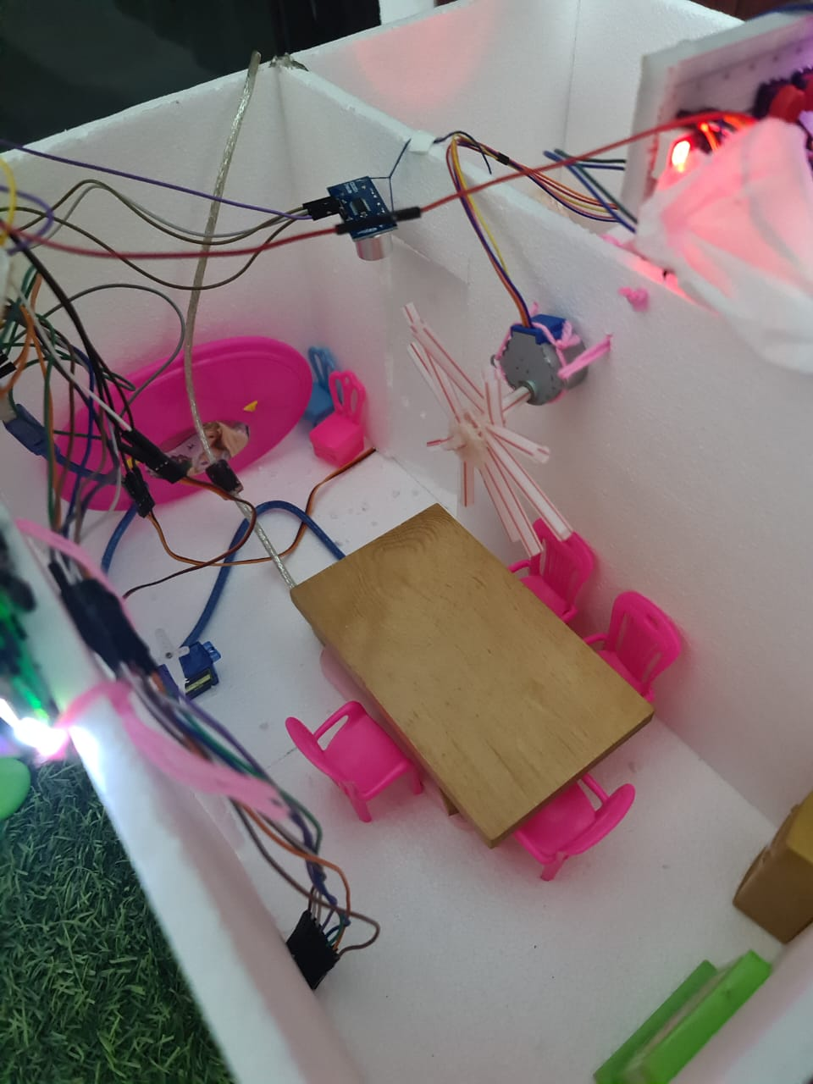
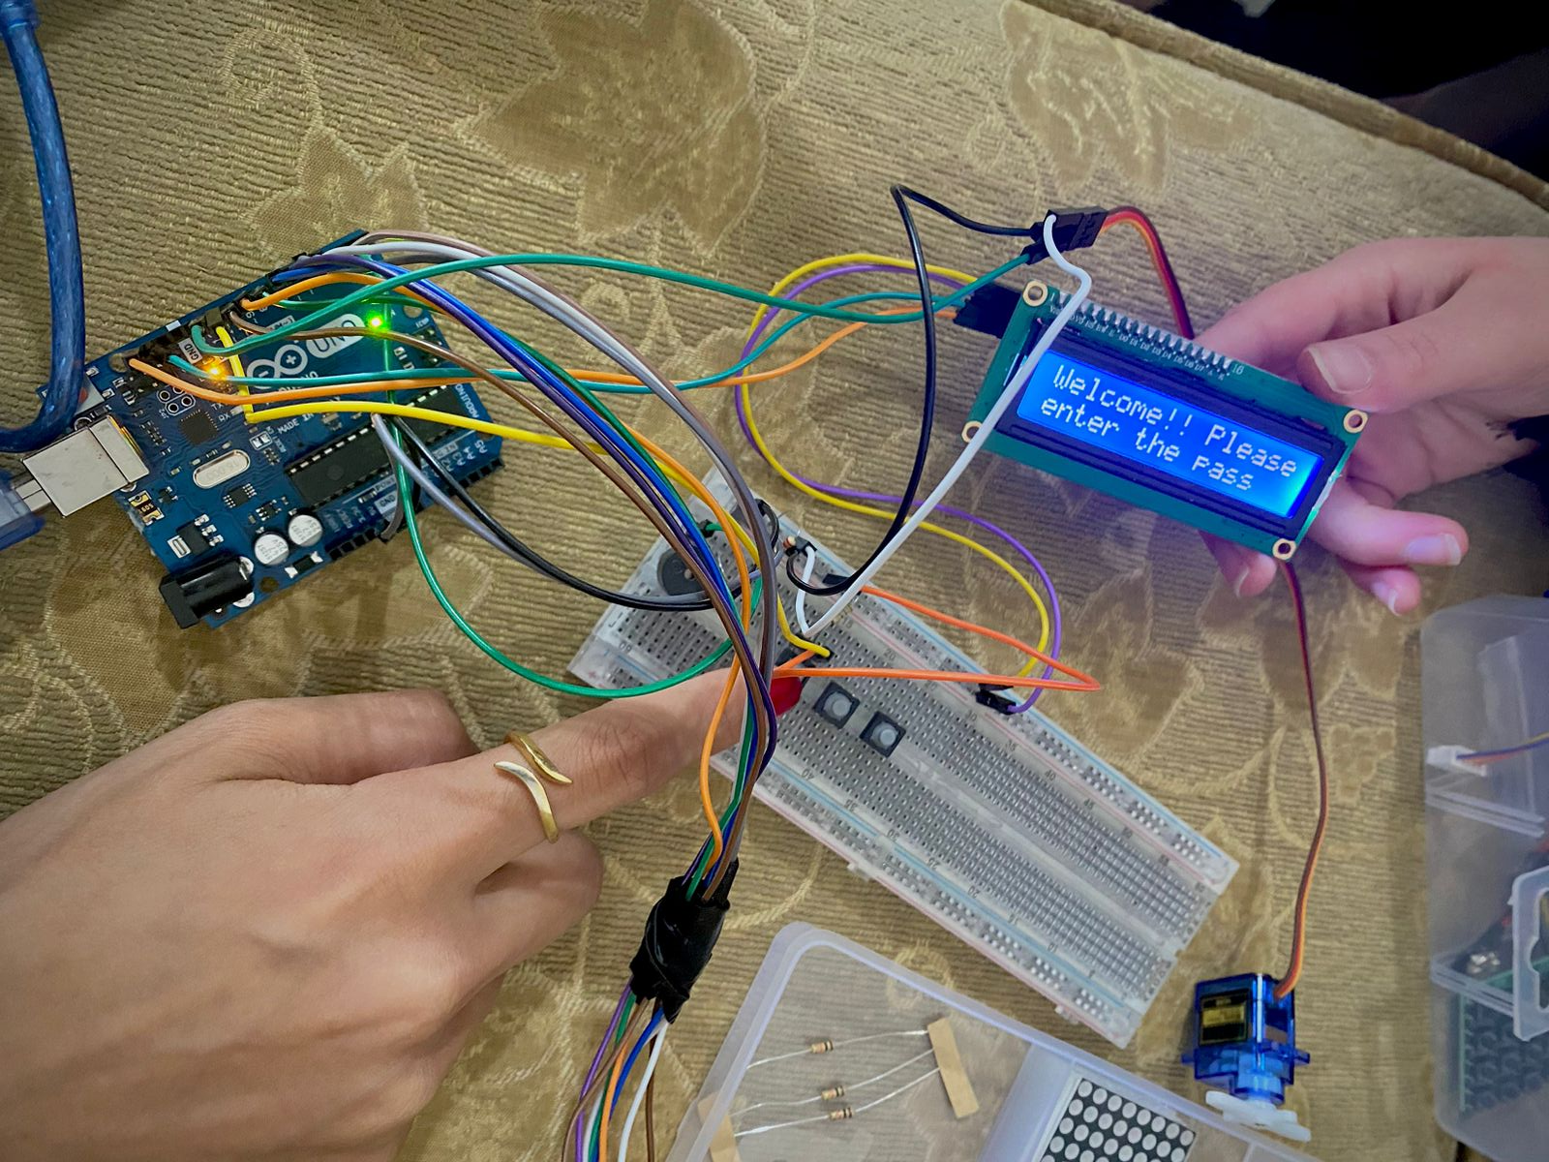
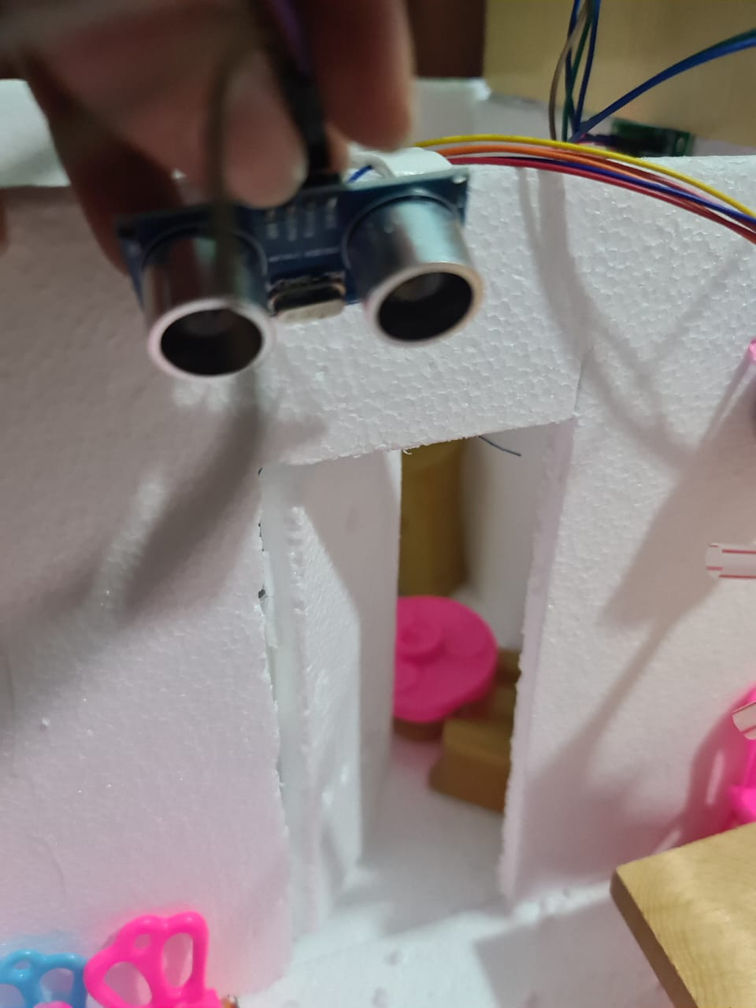

Slide 9
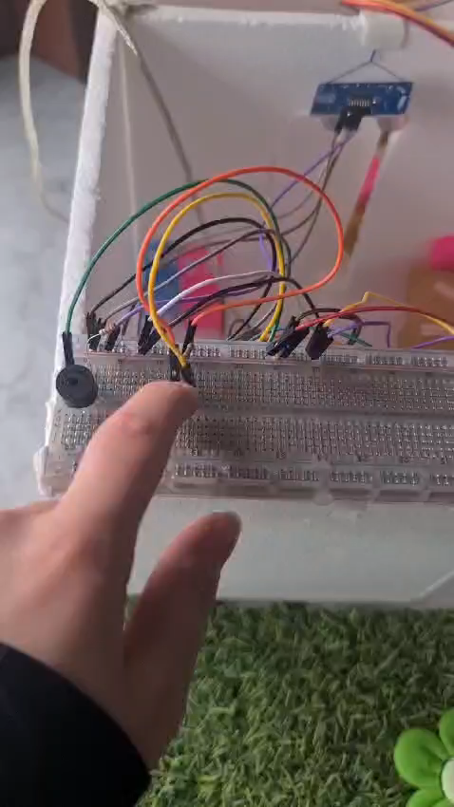

Slide 10
Conclusion
Through this project, I learned how to integrate various sensors and actuators into a single system to automate and enhance the user's experience. I also learned how to program the system to respond to user input and perform specific actions based on the input. Additionally, I gained experience in troubleshooting and debugging the system to ensure it functions correctly.

